Slide 1
Software Testing Project: HardHat
Awab Bin Rizwan
Humza Noor

Slide 2
Dynamics of Blockchain
A New Realm
Backbone of Web 3.0
Cryptocurrency is main application
Tons of development Possibilities

Slide 3
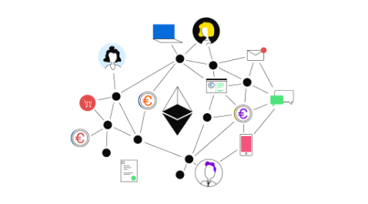
A Look At Ethereum
Blockchain: The New Technology
Web 3.0
Largest Blockchain
Development Environment

Slide 4
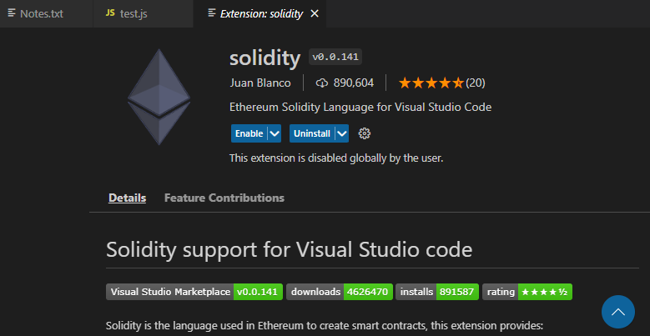
Solidity
The Language of Ethereum
Ethereum Virtual Machine
Other Uses:
Enterprise-oriented
Hyperledger Fabric Blockchain
Proof Of Concept By Swift

Slide 5
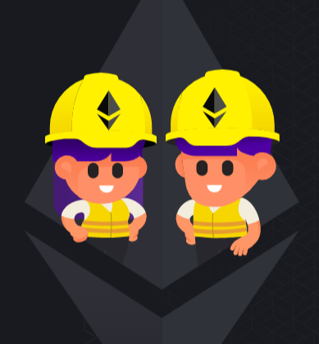
HardHat
Testing Tool for Solidity
Complete Environment
Supported by VS Code

Slide 6
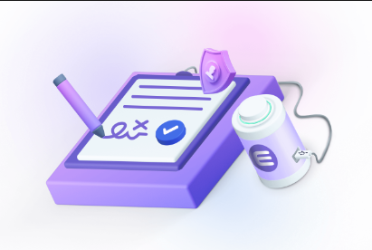
Smart Contracts
Program and Protocol
Controls, automates and Documents
A Sort Of Digital Agreement
What Makes It Smart?

Slide 7
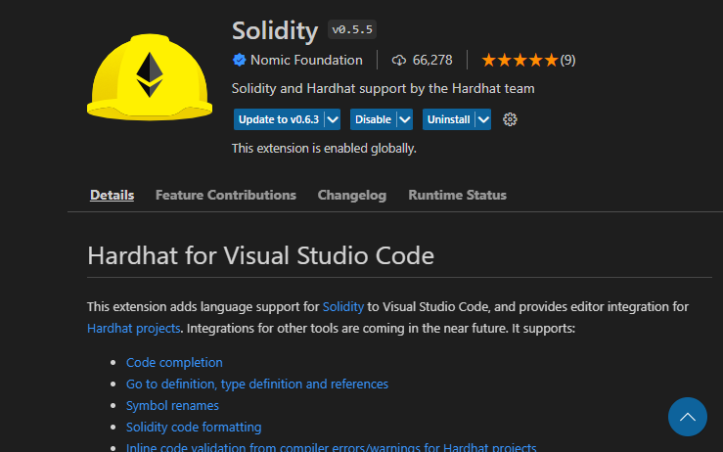
Testing With HardHat
Contracts are written in .sol files
Tested Using Test.js

Slide 8
Thank You!

